Slide 1

ECON 411
Public Sector Economics
PowerPoint Material
2020
J. Fred Giertz
Institute of Government and Public Affairs and Department of Economics
University of Illinois at Urbana
Online Lecture 14—April 19, 2020

Slide 2
Taxation--Plan
Introduction to basic definitions and concepts
  Taxes defined
  Equity and efficiency in taxation
  Basis for allocating tax burden
  Tax rates
  Measuring tax burdens
  Economic impact of taxes
The analysis of important taxes
  Income taxes
  Business taxes
  Consumption taxes
  Wealth taxes

Slide 3

Basis for Taxation
Ability-to-pay (economic capacity)
Consumption
Benefits-received
Base related to usage, e. g., motor fuels
Wealth
Property tax
Death and gift taxes
Sales and VA taxes
Broad-based consumption taxes
Income

Slide 4

Individual Income Taxation
Definition of income
  Measure of ability-to-pay
  Haig-Simons, Accretion concept, Comprehensive Income, Economic income
  “Income may be defined as the algebraic sum of the market value of rights exercised in consumption plus the change in value of the store of property rights between the beginning and end of the period in question.” Simons
  Income = Consumption + Change in Wealth

Slide 5
The U. S. Income Tax--Step by step
Comprehensive Income (Haig-Simons)
  Exclusions
AGI
  Exemptions and deductions
Taxable Income
  Tax rates, filing status
Tax Liability (before and after credits)
  Withholding, estimated payments
Final payment

Slide 6
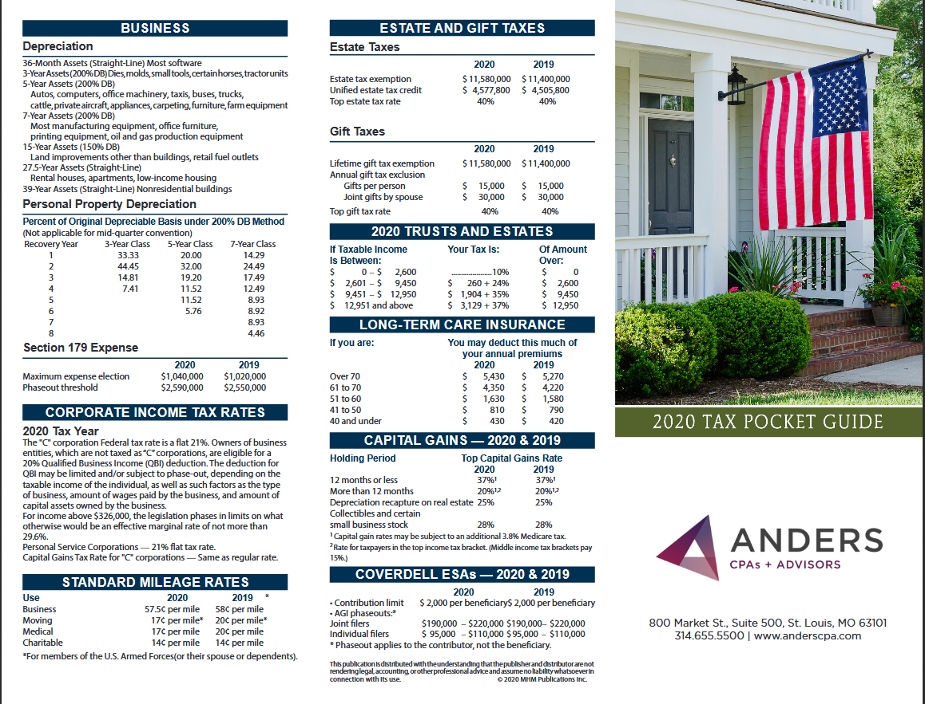

Slide 7
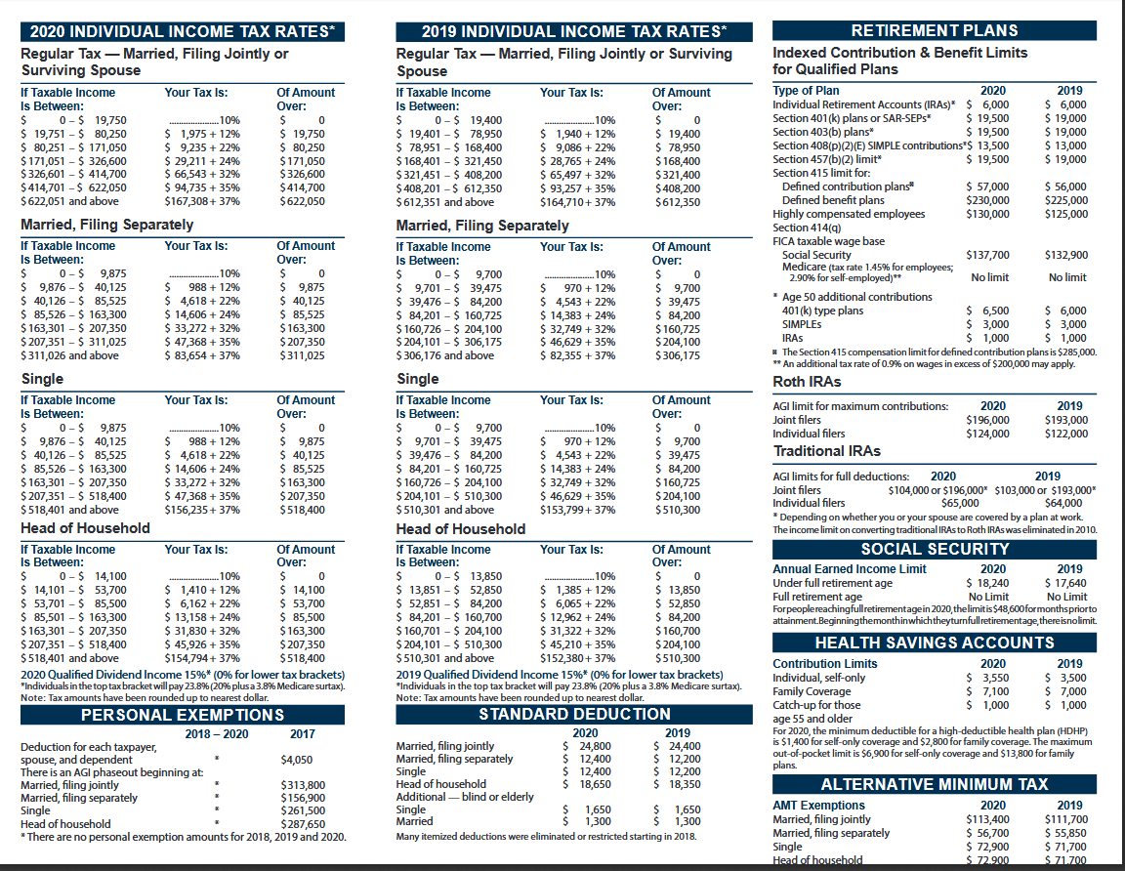

Slide 8
Individual Income Tax Topics
Inflation and capital gains
  Bracket creep
  Taxation of income from capital
Tax treatment of family—equity on various fronts
  Reasons for joint filing
  Marriage penalty and rewards
Income averaging--example
Housing (r-m-d)

Slide 9

Inflation-Hypothetical Situations
Income | Tax
0-20,000 | 10 %
20,000-40,000 | 2,000 + 20% of excess
40,000 and up | 6,000 + 25% of excess
Year | Income | Tax | ATR
2000 | 20,000 | 2,000 | 10%
2000 | 40,000 | 6,000 | 15%
Year | Income | Tax | ATR | Price Index
1990 | 20,000 | 2,000 | 10% | 100
2000 | 40,000 | 6,000 | 15% | 200
Bracket creep

Slide 10
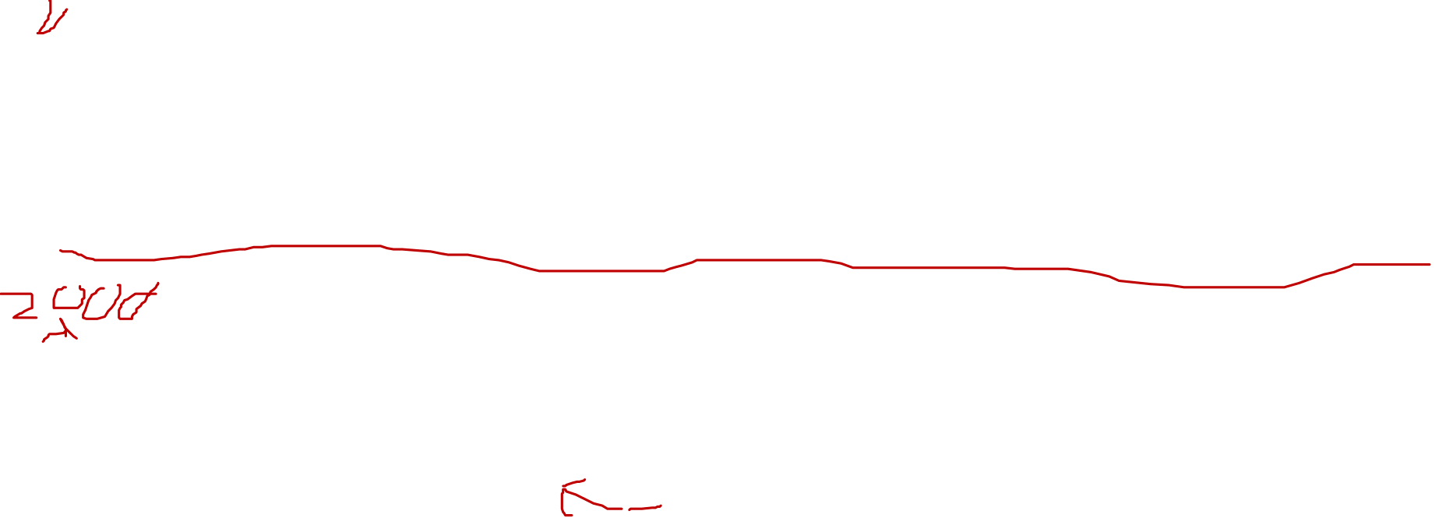
Inflation-Hypothetical Situations
Old--non-indexed
Income | Tax
0-20,000 | 10 %
20,000-40,000 | 2,000 + 20% of excess
40,000 and up | 6,000 + 25% of excess
Year | Income | Tax | ATR | Price Index
1990 | 20,000 | 2,000 | 10% | 100
2000 | 40,000 | 6,000 | 15% | 200
Indexation
New-indexed
The brackets are expanded to reflect inflation
Income | Tax
0-40,000 | 10 %
40,000-80,000 | 4,000 + 20% of excess
80,000 and up | 12,000 + 25% of excess
Year | Income | Tax | ATR | Price Index
1990 | 20,000 | 2,000 | 10% | 100
2000 | 40,000 | 4,000 | 10% | 200

Slide 11
Inflation and income from capital
Income for capital
Nominal and real returns
I_{nom} = I_{real} + ¶
10% = 4%+ 6% (hypothetical)
  Capital gains
    Deferral
    Special rates
    Taxation of inflationary gains
  Dividends
  Interest
  Profits

Slide 12
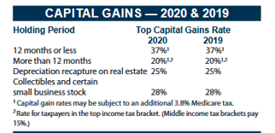

Inflation and taxation of income from capital
Brackets indexed for inflation
Exemptions and minimum deduction indexed for inflation
Return on capital: Nominal rate = real rate + expected inflation
Nominal return taxed—Haig-Simons would only tax real return
because is is the portion that represents ability to consume without reducing assets
Capital Gains
  Taxed when realized, not when accrued
  Reduces present value of tax cost
  Haig-Simons would tax when accrued
  Inflationary gain as well as real gain taxed
  Haig-Simons would tax only real gain by allowing basis to be adjusted for inflation
  Special rates for long-term capital gains
  Step of in basis for capital gains at death (capital gains not taxed at death and heirs not subject to tax)
Year Value Basis Capital Gain Price Index
1990 | 200,000 |  |  | 100
2000 | 500,000 | 200,0000 | 300,000 | 200
Adjusted
1990 | 200,000 |  |  | 100
2000 | 500,000 | 400,0000 | 100,000 | 200

Slide 13
More about capital gains

Slide 14
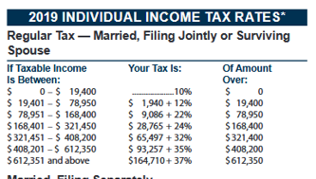
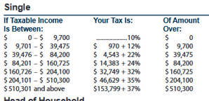

Tax treatment of family
Income | Tax
0-20,000 | 10 %
20,000-40,000 | 2,000 + 20% of excess
40,000 and up | 6,000 + 25% of excess
Family A | Income | Tax | ATR
Spouse 1 | 40,000 | 6,000 | 15%
Spouse 2 | 0 | 0
Total | 40,000 | 6,000 | 15%
Family B | Income | Tax | ATR
Spouse 1 | 20,000 | 2,000 | 10%
Spouse 2 | 20,000 | 2,000 | 10%
Total | 40,000 | 4,000 | 10%

Slide 15

Income Splitting
Income | Tax
0-40,000 | 10 %
40,000-80,000 | 4,000 + 20% of excess
80,000 and up | 12,000 + 25% of excess
Family A | Income | Tax | ATR
Spouse 1 | 40,000
Spouse 2 | 0
Total | 40,000 | 4,000 | 10%

Slide 16
Individual Income Tax Topics
(continued)
Taxation of housing—owning vs. renting
  R-m-d
Household work (child care, housekeeping, repair, etc.)
AMT—Alternative Minimum Tax
Death and gift taxes and income tax

Slide 17
Housing—Owning vs. Renting
Renter
  Rent
  Less maintenance less depreciation less property tax less mortgage interest
Owner occupant
  No imputed rent but property tax and mortgage interest deductable
Difference—(R-M-Dep)
  Itemization vs. non-itemization adds to complexity

Slide 18
An Example for 1947
Ross Lockridge, Jr. and Raintree County
Spreading income– no averaging and high marginal rates
Discussion about prize—negotiated for a 5-year payout
His manuscript had won a $150,000 novel prize from MGM studios that included the studio's right to make a film from the novel.
Splitting income between couples–no joint returns
$25,000 Payment to wife–could it be justified
1948 first year of joint filing, income splitting and common property states
Contribution to foundation for father.
Edmund Wilson, Cold War and the Income Tax: A Protest
Joe Louis

Slide 19


Slide 20
Impacts on Work
Theoretical possibilities
  Income and substitution effects
Notable examples
Primary worker
Secondary worker
Impacts on Savings

Slide 21
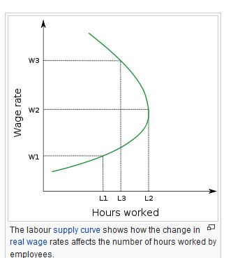
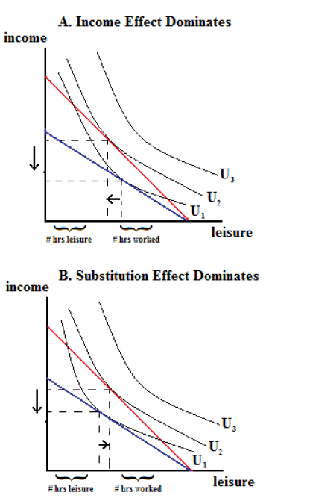

Primary worker
Secondary worker

Slide 22
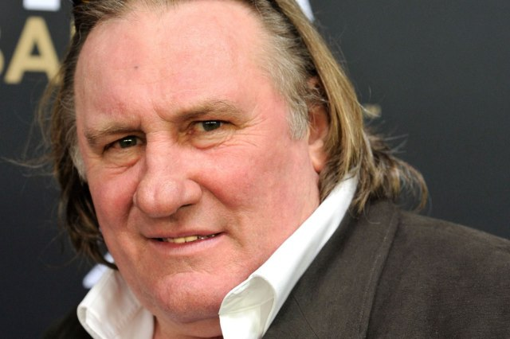


Eduardo Saverin

Slide 23

Taxman
George Harrison
Let me tell you how it will be,
There's one for you, nineteen for me,
Cause I'm the taxman,, yeah, I'm the taxman
Should five percent appear too small,
Be thankful I don't take it all,
'Cause I'm the taxman, yeah, I'm the taxman
If you drive a car, I'll tax the street,
If you try to sit, I'll tax your seat
If you get too cold, I'll tax the heat,
If you take a walk, I'll tax your feet, taxman,
'Cause I'm the taxman, yeah, I'm the taxman
Don't ask me what I want it for,
(ha ha Mr. Wilson)
If you don't want to pay some more,
(ha ha Mr. Heath)
'Cause I'm the taxman, yeah, I'm the taxman
Now my advice for those who die,
Declare the pennies on your eyes,
'Cause I'm the taxman, yeah, I'm the taxman
And you're working for no one but me.

Slide 24
State Income Taxation
General issues
  Taxation and Mobility
  Interaction with federal tax
Illinois
  Definition—begins with AGI with modifications
    Include all capital gains and S & L interest
    Excludes retirement income
  4.95 percent flat rate
  Property tax credit (5 percent)
  Illinois EITC

Slide 25
Introduction to the Corporate Income Tax (and Related Issues of Business Taxation)
What is a corporation?
  Legal vs. economic
Rationale for tax corporations
  Avoiding taxing individuals??
  Two Views
    Absolutist--benefits-based tax reflecting advantage of corporate form
    Integrationist—dealing with shortcomings of the individual income tax
  Which rationale applies to U. S.?
    Treatment of dividends and retrained earnings

