Slide 1
ECON 411 Public Sector Economics PowerPoint Material 2020
J. Fred Giertz
Institute of Government and Public Affairs and Department of Economics
University of Illinois at Urbana
Online Lecture 5—April 4, 2020

Slide 2
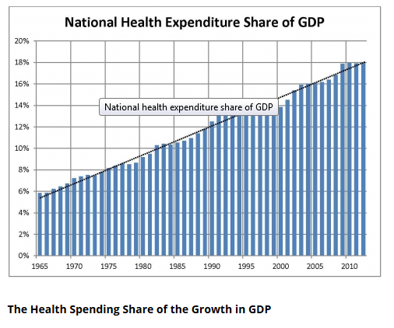
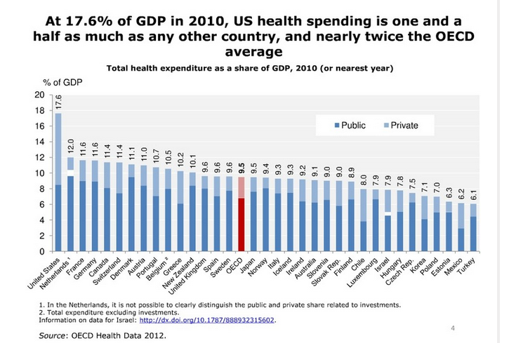
Healthcare Spending

Slide 3
Why is healthcare different?
Explanations for government involvement
Pure public good?
Externalities?
Public health issues
Current COVID-19 crisis
In-kind redistribution
Assumption of universal access to “best” treatments and rapid technical advance
Third party payers
Principal-agent problems

Slide 4
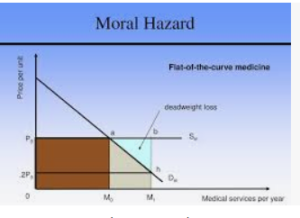
Why is healthcare different?
Third party payers—insurance and government (Medicare, Medicaid, VA, etc.
Lessons from insurance
Moral hazard problems
Adverse selection
Asymmetric information problems (lemons)
Applications to health care

Slide 5
Moral Hazard
MB &
MC
Healthcare

Slide 6
Asymmetric Information and Adverse Selection
Asymmetric Information and the lemon problem
Adverse selection methods of dealing with it
Applications to healthcare

